Slide 1


EMBER INSIGHT
Through the radar mirror: unveiling terrestrial processes with SAR
NASA SPACE APP CHALLENGE 2025

Slide 2
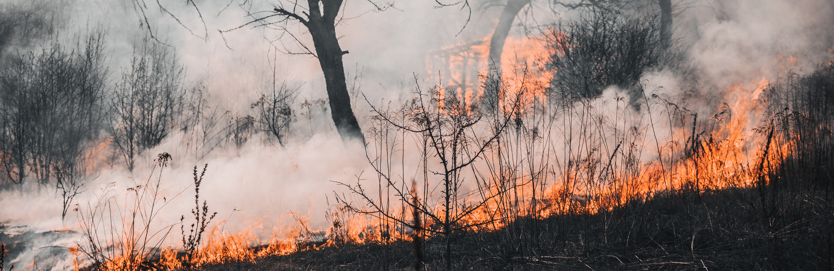
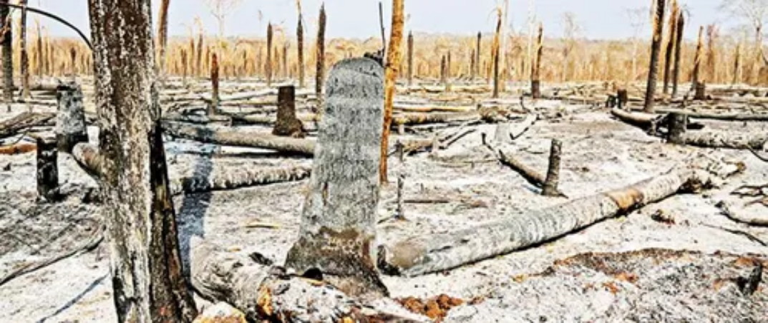

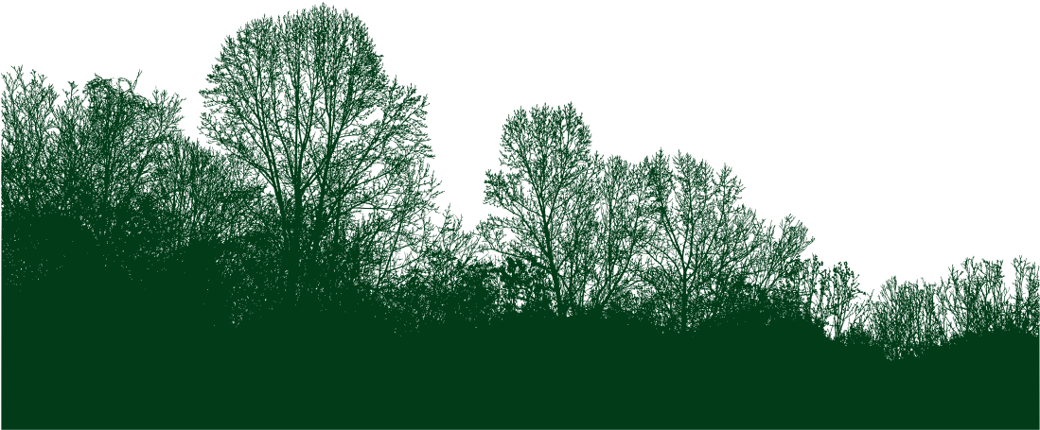
Fires in the Chiquitania

Slide 3
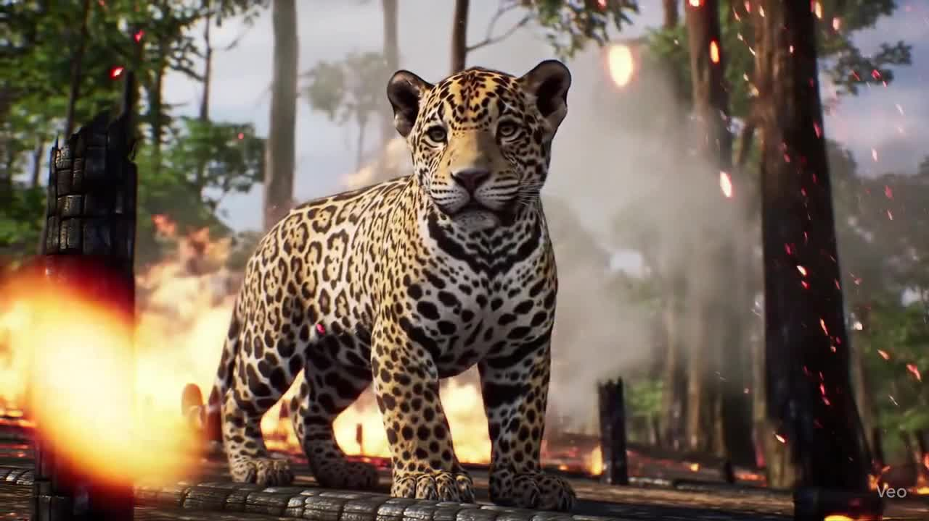
EMBER INSIGHT

Slide 4
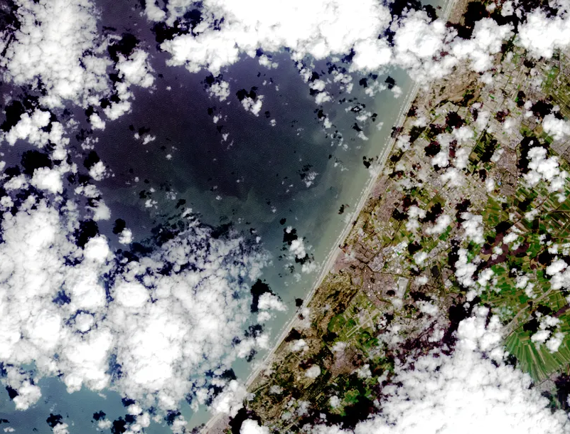
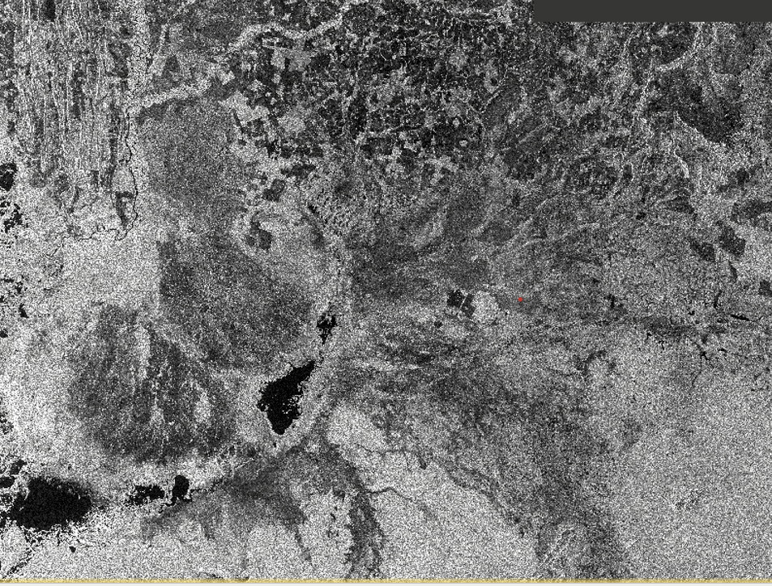

COMPARISON
IMAGEN DE SATELITE TRADITIONAL
IMAGEN SAR
PREPROCESSING DATA FROM ASF, NASA

Slide 5
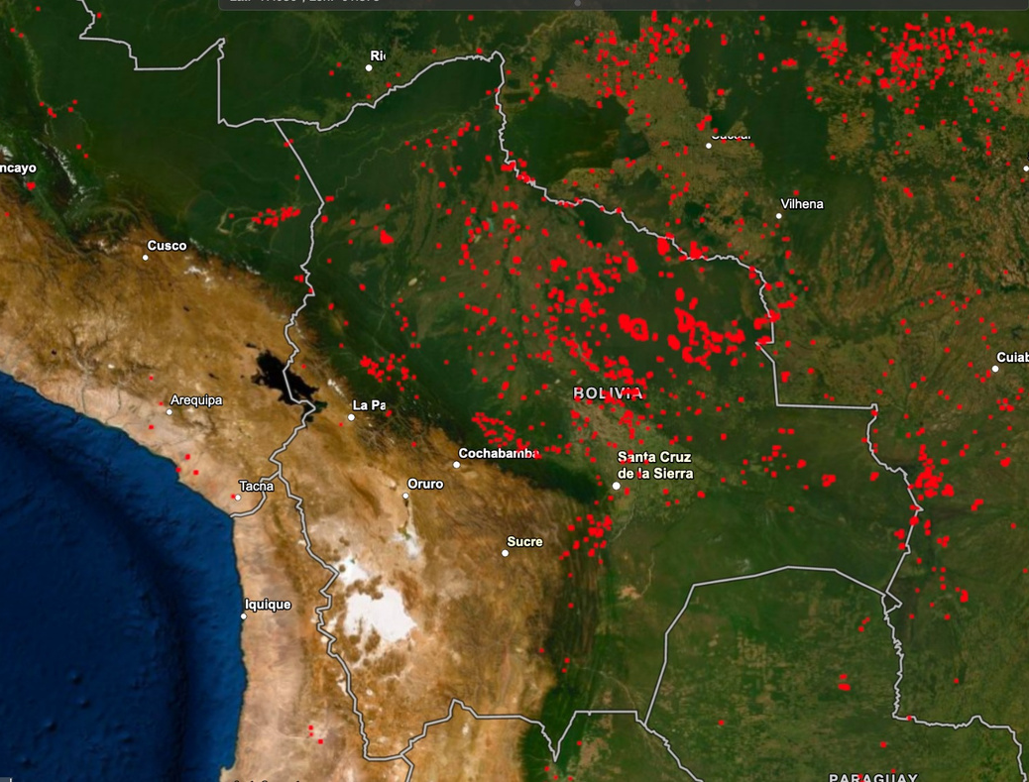
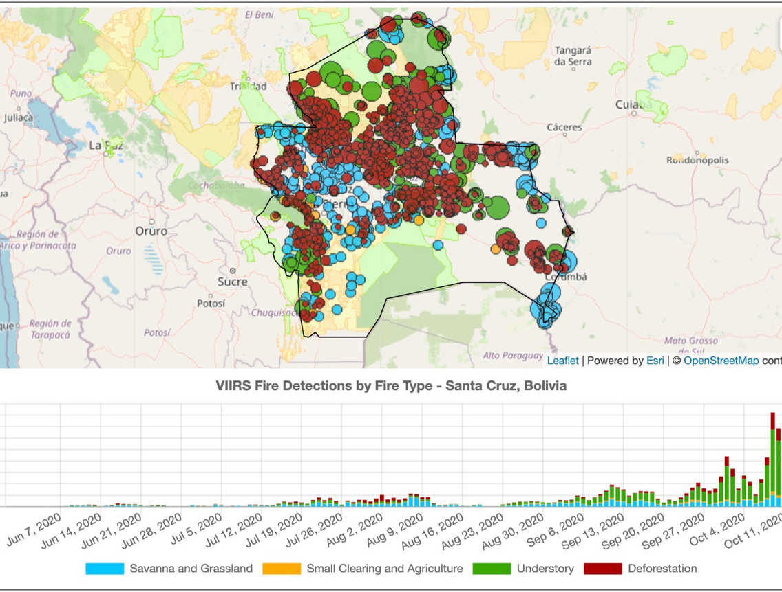
MAIN RESULTS
MODIS/VIIRS.
Sentinel-1 (SAR)

Slide 6
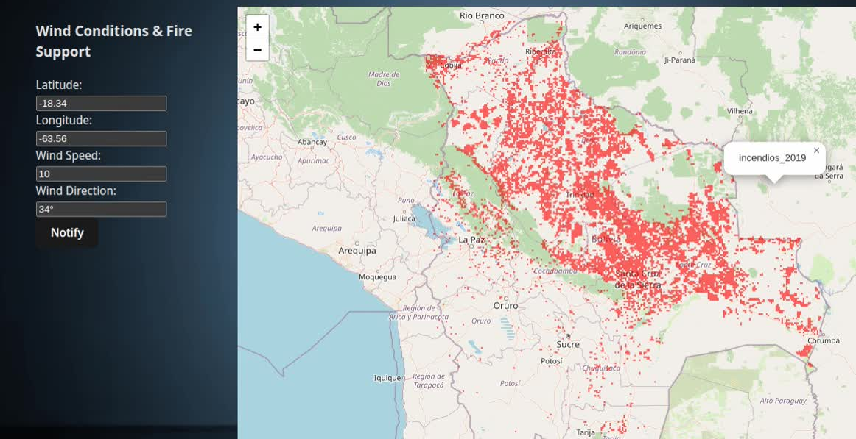
DEMO
Detection: Where is the fire burning right now?
Prediction: Where it will move TOMORROW.
Visualization: Maps that any firefighter can understand today

Slide 7

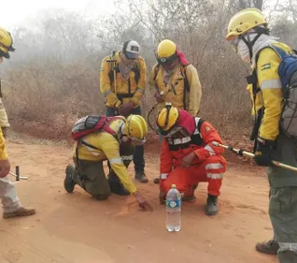
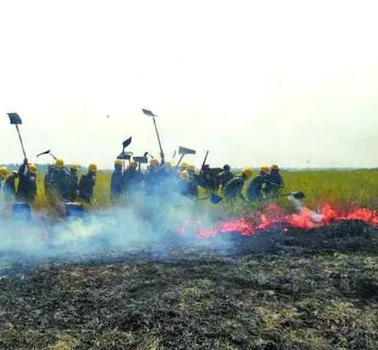
Users and Impact
Fundación para la Conservación del Bosque Chiquitano
Bomberos
Comunidades
https://www.facebook.com/FCBC.org
Bomberos GEOS-Primera Compañía
Prevención para comunidades

Slide 8
Thank you for your attention

